Slide 1
Importance of NexBlu Nitrogen for Successful Sidedress Applications
Presented by Dr. Brian Cornelious, Steve Sexton
& Kent Moore
May 11, 2021 | 8 am CT

Slide 2
General Nutrient Efficiency Is Limited
Primary Nutrient | First Year Efficiency/Recovery
Nitrogen | ~ 50%
Phosphorus | 10-30%
Potassium | 20-60%
Mineralization, or the release of nutrients, must occur before plants can utilize them for growth and development

Slide 3
4 Key Decisions to Make
When to apply
How to apply
V4 – V8 is optimal timing
Only 20-25 pounds of N have been used to this point
Rapid uptake of 100-120 pounds or more from V8 through tassel/silking
Inject
Dribble
Broadcast
Fertigation
Y Drops
What to apply
Rate to apply
Anhydrous Ammonia
Urea
UAN
Based on soil test recommendations, yield goals and preplant N applied
Over 75% of N and 50% P is taken up from VT thru Grain Fill.
Univ of NE research shows an Extract application increased Bray 1 by 6.7 ppm.

Slide 4
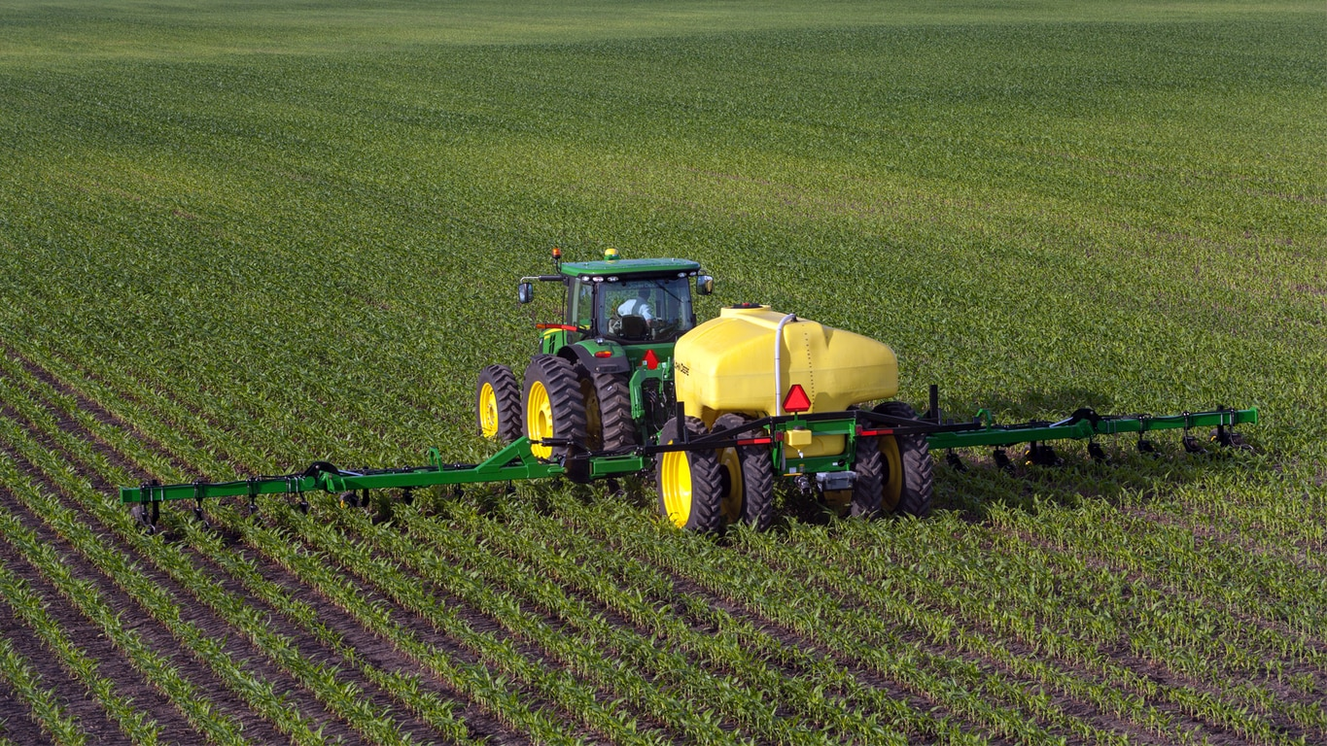
How NexBlu Influences the Availability of Ammonium in UAN
50% of UAN is in the urea form and must be converted for plant use
Urea reacts with water in the soil immediately after application through a biological process called hydrolysis
The biocatalyst component in Extract (found in NexBlu) aids in the hydrolysis of urea to plant available NH₄⁺
The increase in plant available NH₄⁺ resulting from an application of Extract drives increased N availability, efficiency and plant uptake
The Hydrolysis Process: Urea → Ammonium Carbonate → Ammonia gas (NH₃) → Ammonium (NH₄⁺)

Slide 5
What Conditions Favor Best Responses from Sidedress N Applications?
Little or no preplant N applied
Saturated soils in warm conditions after planting
Course (sandy) soils receiving heavy rains after planting
High preplant N loss due to weather
N deficiency symptoms early (prior to V3-4)
High plant populations with yield expectations greater than preplant N applied

Slide 6
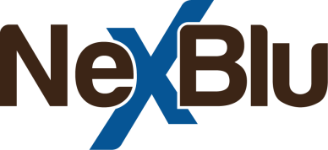
The Blue Nitrogen

Slide 7
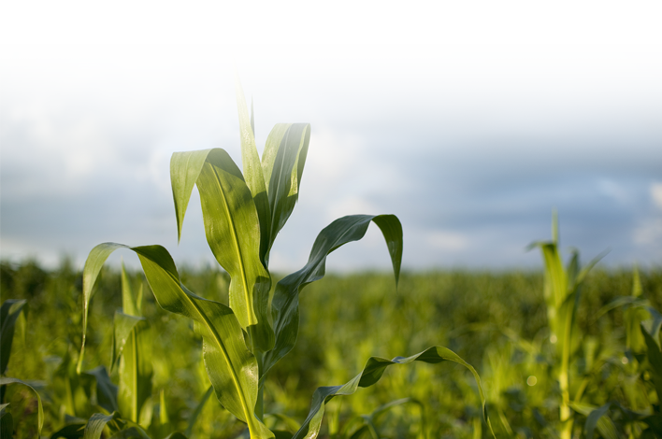
Tool for Efficient Use of UAN 28/32
NexBlu is a proprietary blend of fertilizer biocatalyst and UAN,
Unique to Loveland Products,
Designed to ensure more value for every pound of applied N
REPLACES ALL STANDARD UAN APPLICATIONS
Key product benefits:
Extends nutrient availability later into the season
Improves total nutrient use efficiency

Slide 8
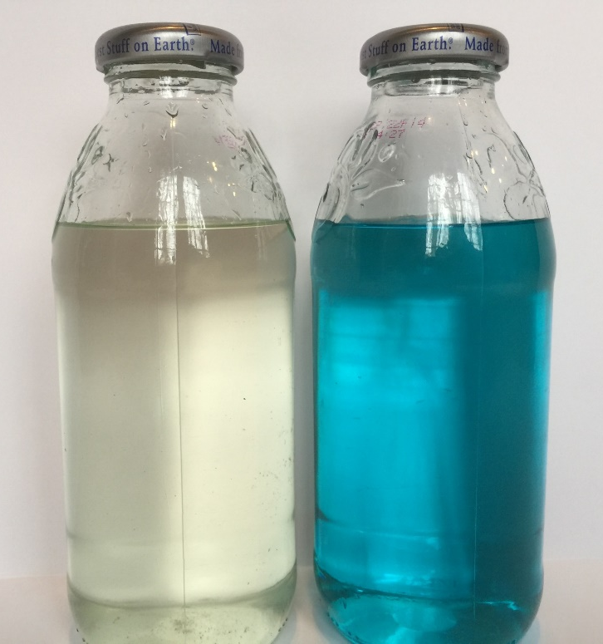
What Is NexBlu?
An enhanced proprietary liquid nitrogen
Enhanced nitrogen that contains proprietary biochemistry
UAN
Proprietary to Nutrien
NexBlu 31 = 31.4-0-0-0.3S
NexBlu 27 = 27.6-0-0-0.3S
NexBlu S = 26-0-0-2.7S

Slide 9
What Are the Benefits of NexBlu?
Complete nitrogen solution
Promotes more even crop emergence
Increases soil nutrient availability later in the season
Improves total nutrient use efficiency
Provides supplemental sulfur

Slide 10
How NexBlu Fits Any UAN Sidedress Application
Your complete N solution (apply just like you would UAN)
Makes nutrients available later into the season
Better utilization of N due to a more “well balanced diet”
Unlock potential of plant-available nutrients that may be bound up within soil and make more total nutrients available to the plant

Slide 11
NexBlu 31 Corn Trial
Corn – Clay, KY (2019)
Bu/a
200# NH₃
100# NH₃ + 75# ESN
175# ESN sidedress
175# NH₃
175#

Slide 12
NexBlu 31 Corn Trial
Corn – Union County, KY (2020)
Bu/a
Competitor Product

Slide 13
Summary
NexBlu is an enhanced N solution that replaces any standard UAN application
Critical sulfur needs are addressed with NexBlu vs UAN alone
The biocatalyst technology in NexBlu facilitates the cycling and uptake of more than just N – “Well balanced diet”
Proven ROI across multiple field trials

Slide 14
Thank you!
Questions?
Contact: bcornelious@agricen.com or ssexton@Agricen.com

